Slide 1
Azure Data Factory & Flows Level – 300 – Day 3
Sashank Pappu
Azure Data & AI Specialist

Slide 2


Sashank Pappu
Azure Data & AI Specialist.
Certified from MIT on ‘Advanced Analytics and Big Data Challenges’. Technology Enthusiast and Data Specialist. Certified Designer in Computer Vision
• Microsoft Certified Power BI Developer. • Microsoft Certified Azure Machine Learning Developer from Microsoft Virtual Academy • Certified on Practical Data Analytics with Microsoft Cortana Intelligence Suite.
9+ years of total experience as Data Specialist and Data Engineer.
Certifications
Experience
Currently working as Independent Consultant on Azure Data & AI and Enterprise Trainer on Azure Data Analytics , Cortana Intelligence Suite and Cognitive Sciences
Expert facilitator and corporate behavioral trainer with 5 years of experience in designing programs, content development , Data Analytics and Machine Learning.
Role
Training
Sri Nag Sashank
You can see me on – Sashankpappu.com

Slide 3




The session will span for 5 days & it is mandatory to attend all the days.
Self-Paced labs have been developed & access will be shared during the session.
The audience can participate in the leaning. However, it DOES NOT come with “Azure Subscriptions” & request users to arrange on their own.
A proctor will be available to take your queries via “Chat” window. Kindly “MUTE” and do not disturb the presenter.
The sessions are recorded. Will be made available through LMS at the end of series.
Note: More trainings on the same & similar topics would be delivered in near future. Keep your options open.
Guidelines for the event

Slide 4
Agenda
Scope of Azure Data Ecosystem.
Azure Data Factory & Components
Real World Use case Overview
Hands on with ADF
Parameterization of ADF Pipelines.
Best Practices and DevOps.

Slide 5
Data Factory

Slide 6
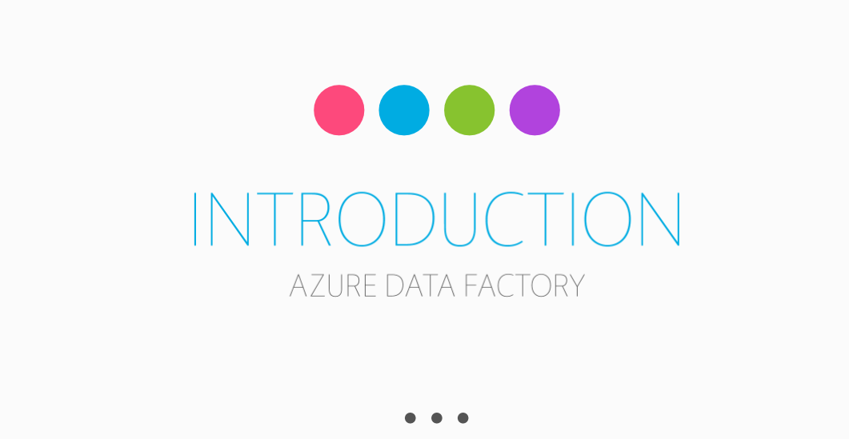

Slide 7
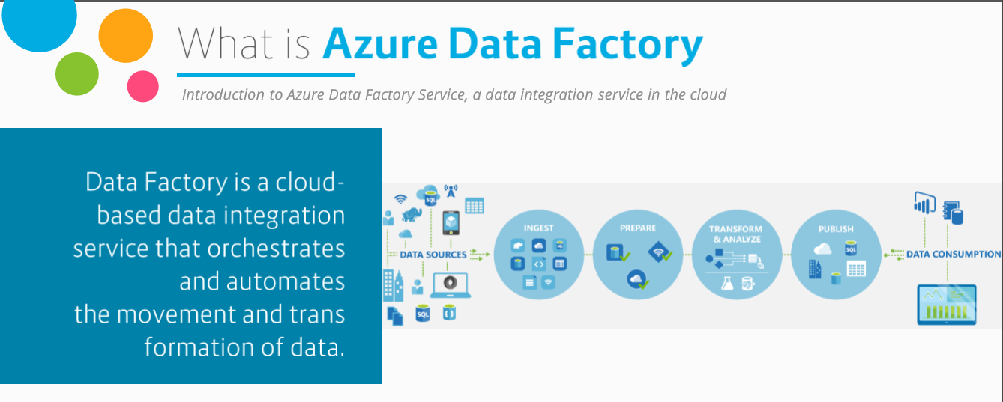
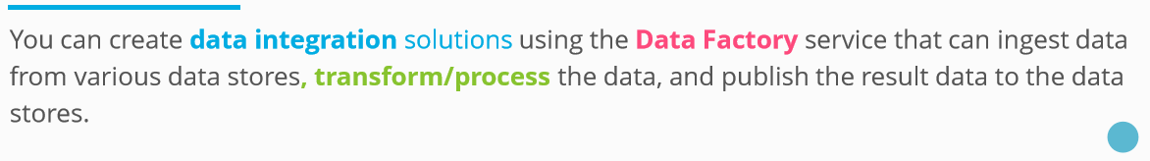

Slide 8
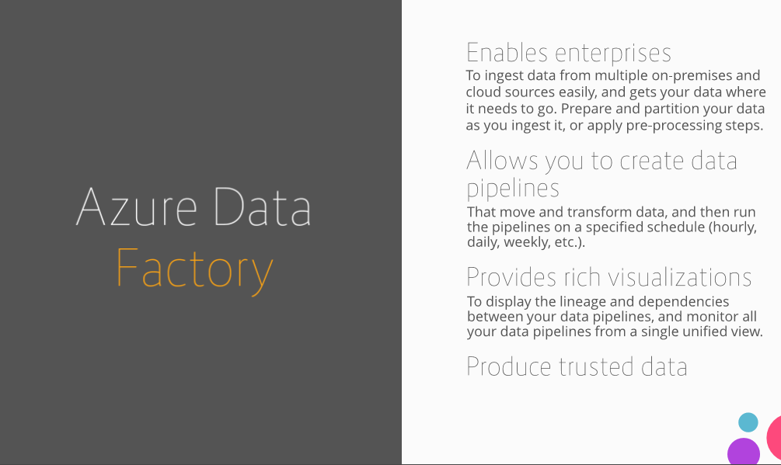

Slide 9
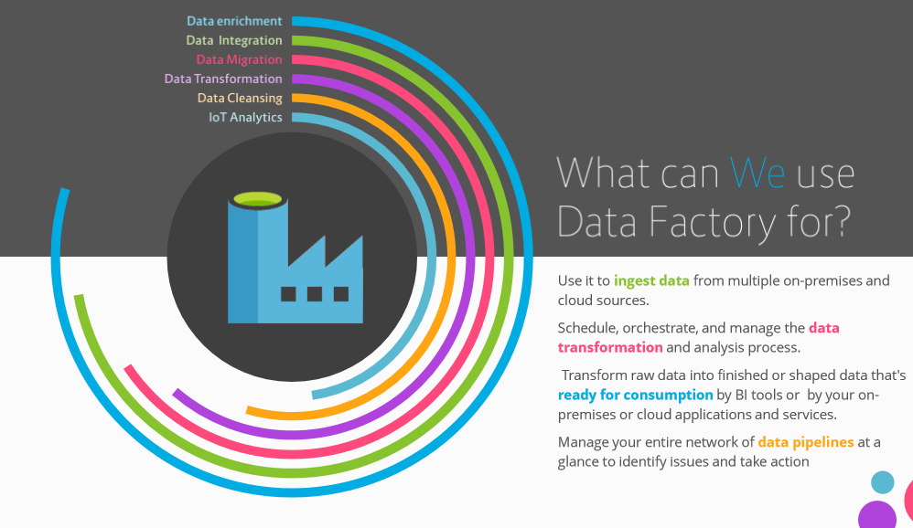

Slide 10
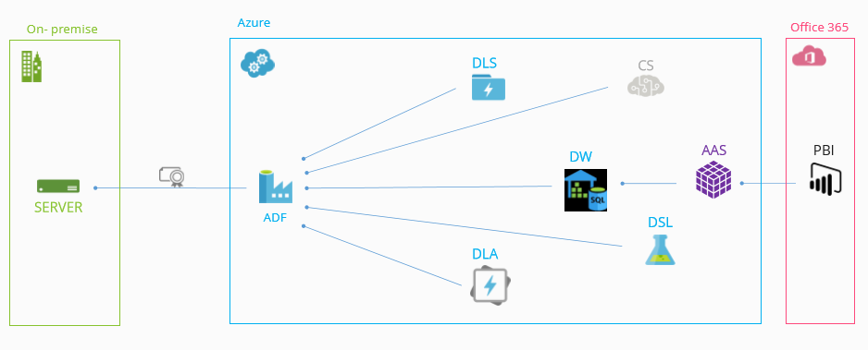
Data Sources Usage

Slide 11
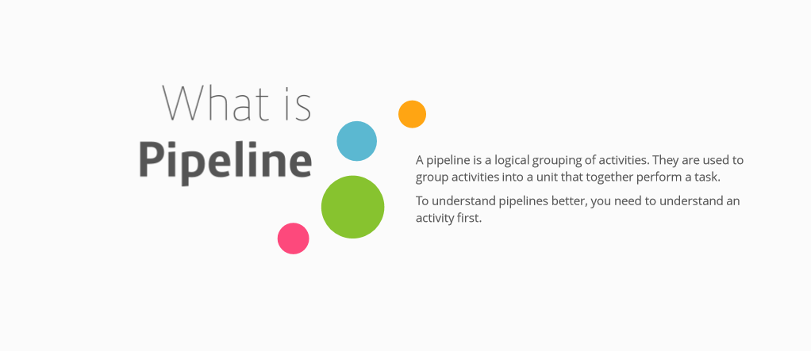

Slide 12
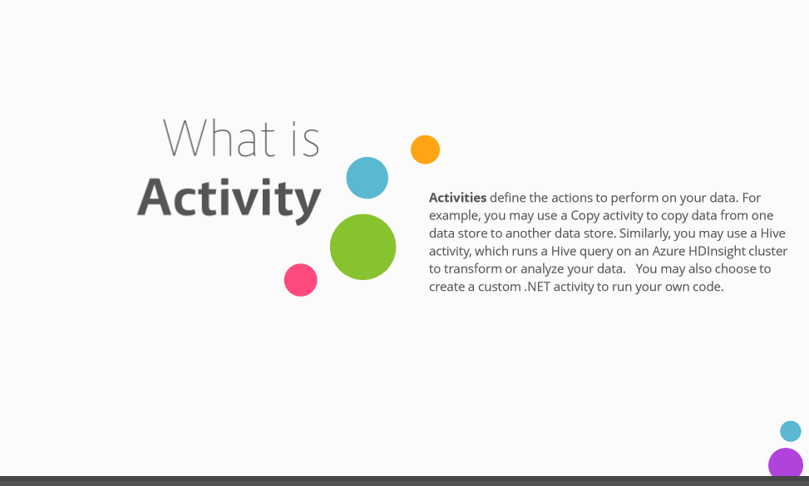

Slide 13
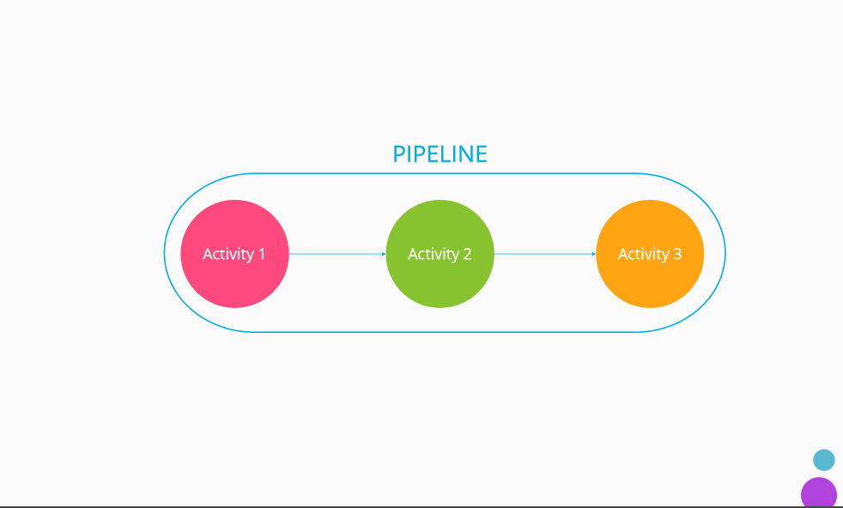

Slide 14
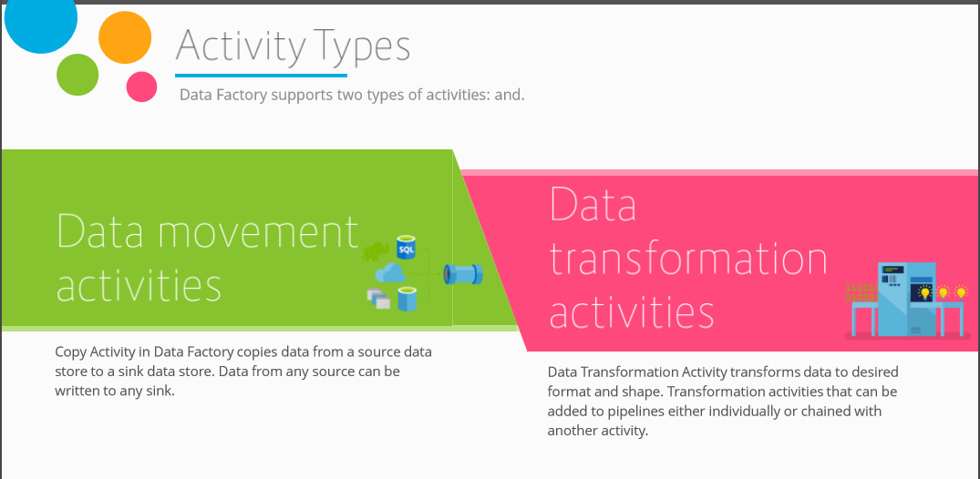

Slide 15
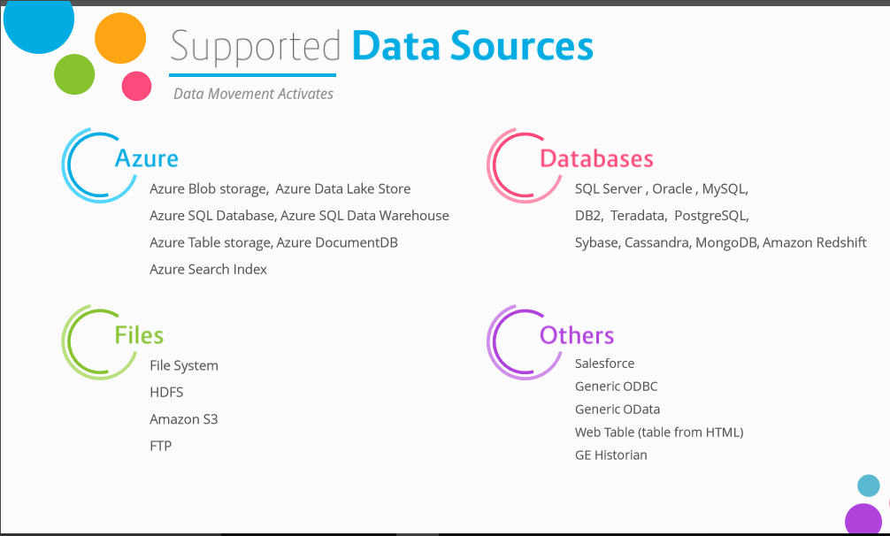

Slide 16
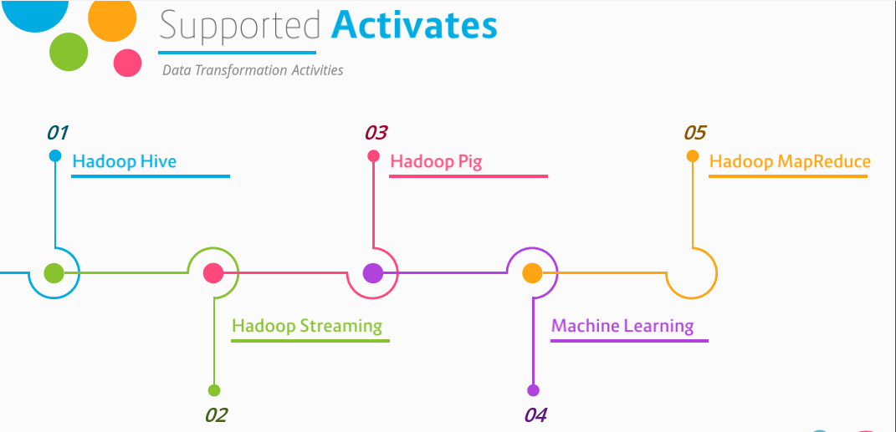

Slide 17
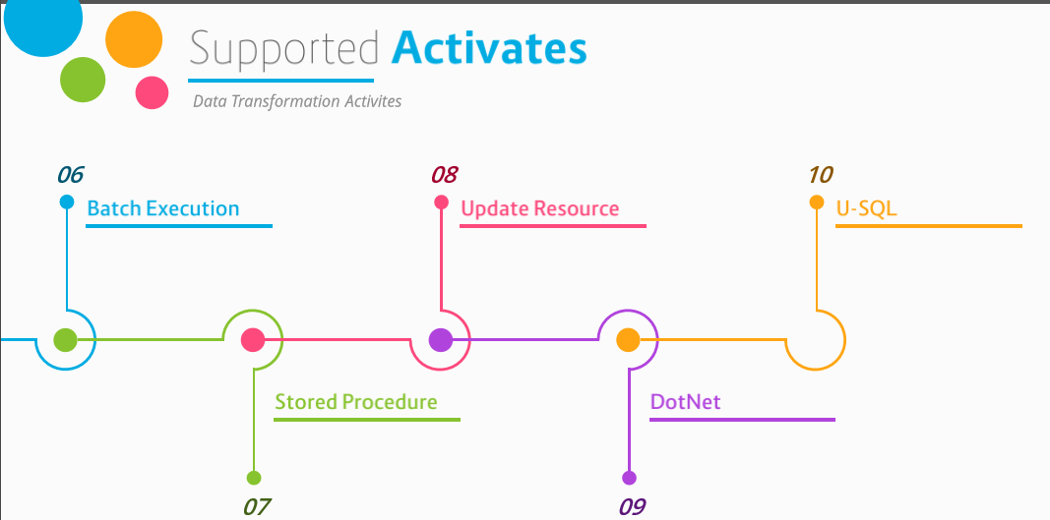

Slide 18
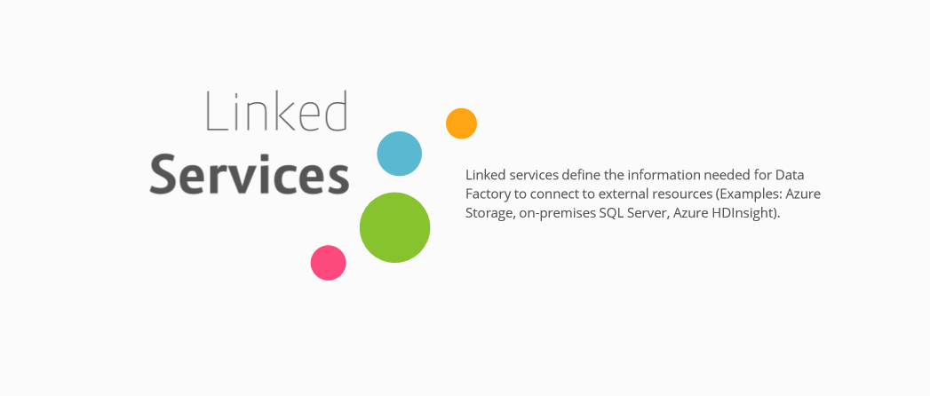

Slide 19
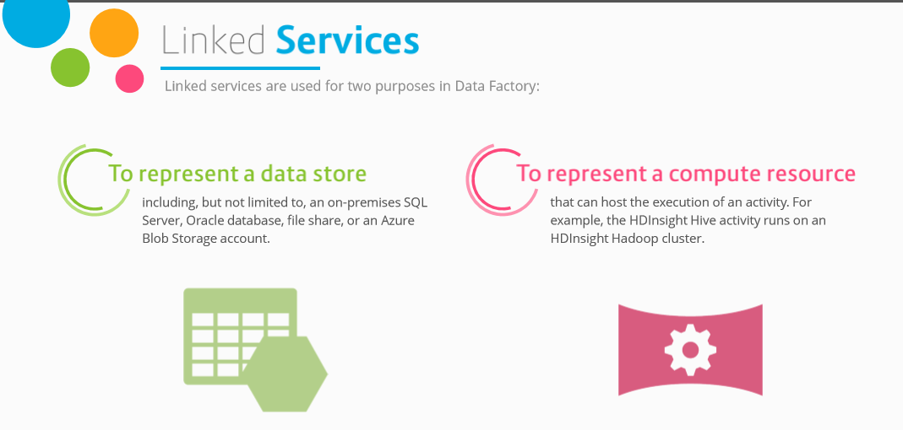

Slide 20
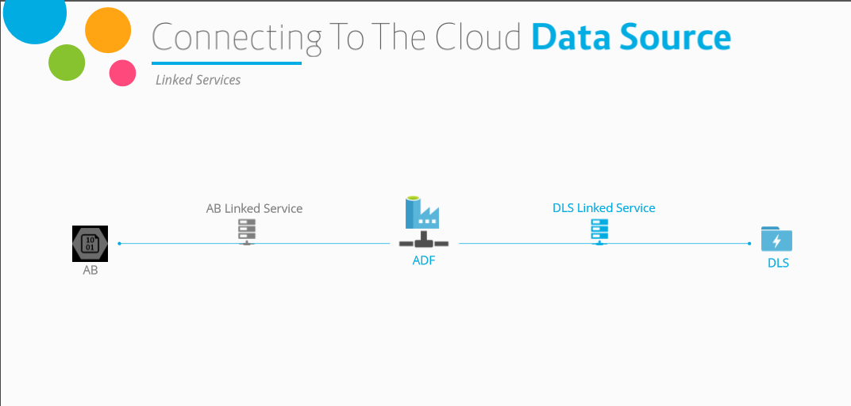

Slide 21
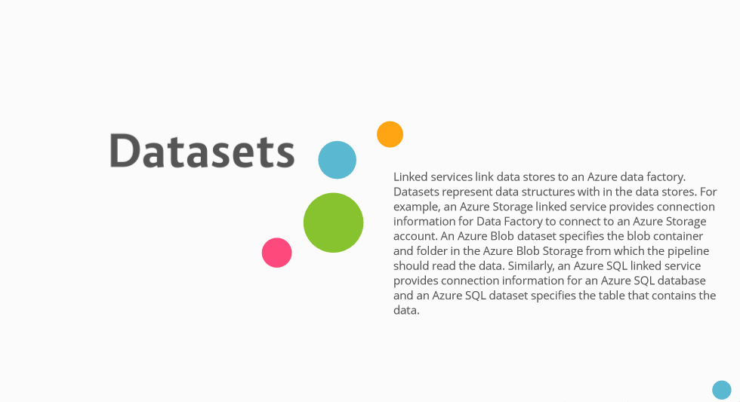

Slide 22
2. Create the Data Factory
Portal, PowerShell and Visual Studio
Notes:
Setting Up: https://azure.microsoft.com/en-us/documentation/articles/data-factory-build-your-first-pipeline/

Slide 23
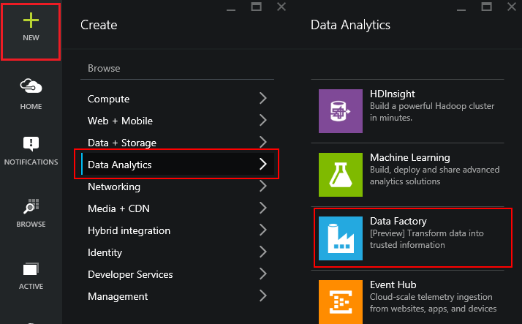
Using the Portal
Use in Non-MS Clients
Use for Exploration
Use when teaching or in a Demo
Notes:
LAB 2:
Open the file StudentWorkbook.txt
Complete Lab 2
Overview: https://azure.microsoft.com/en-us/documentation/articles/data-factory-build-your-first-pipeline/
Using the Portal: https://azure.microsoft.com/en-us/documentation/articles/data-factory-build-your-first-pipeline-using-editor/

Slide 24
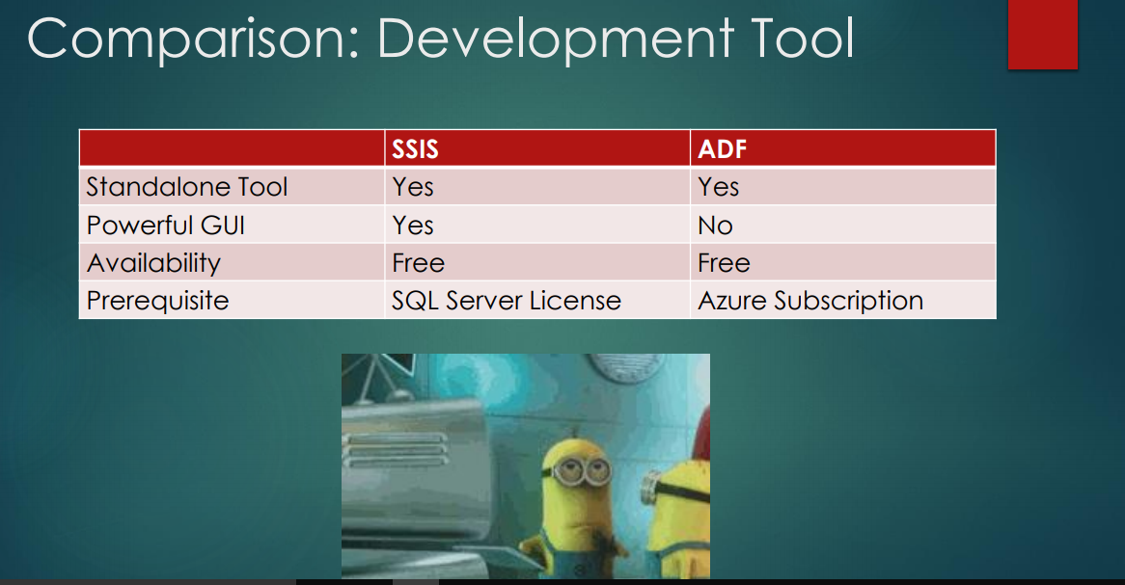

Slide 25
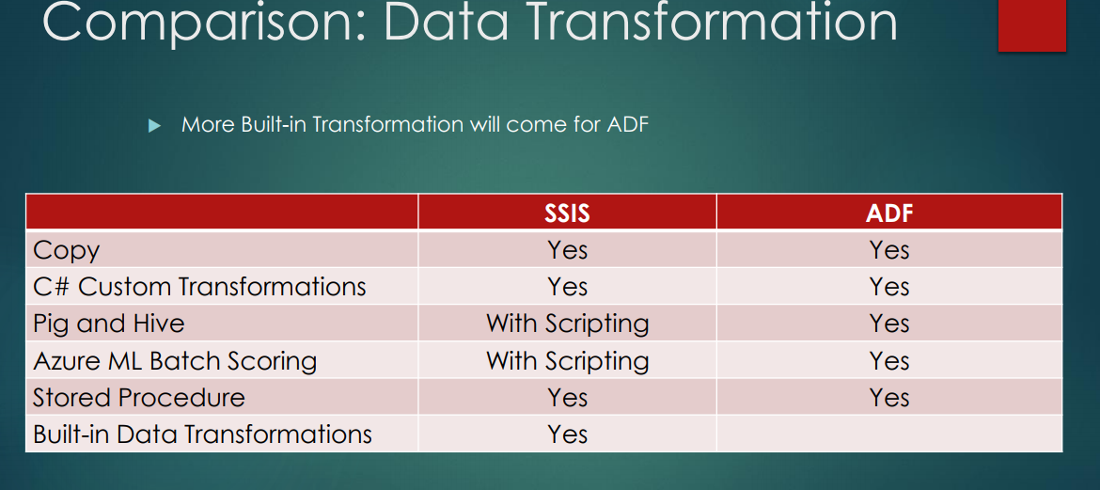

Slide 26
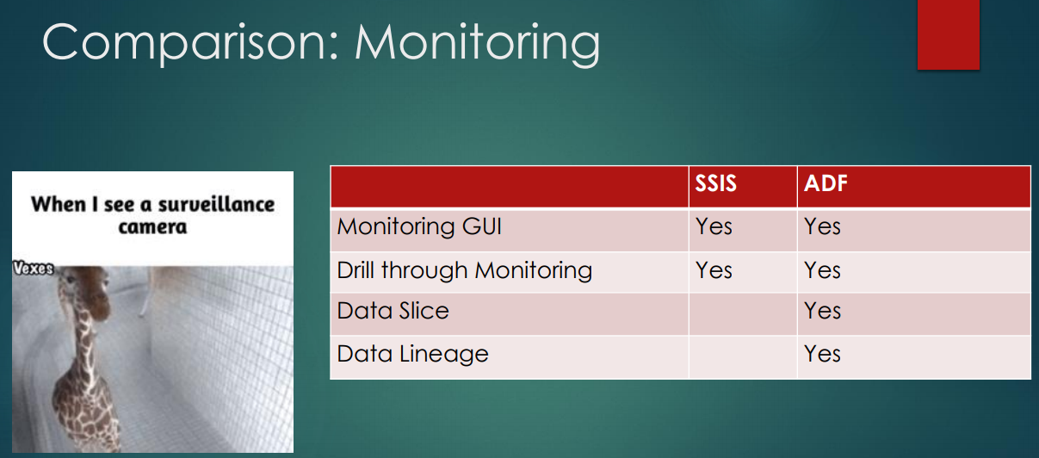

Slide 27
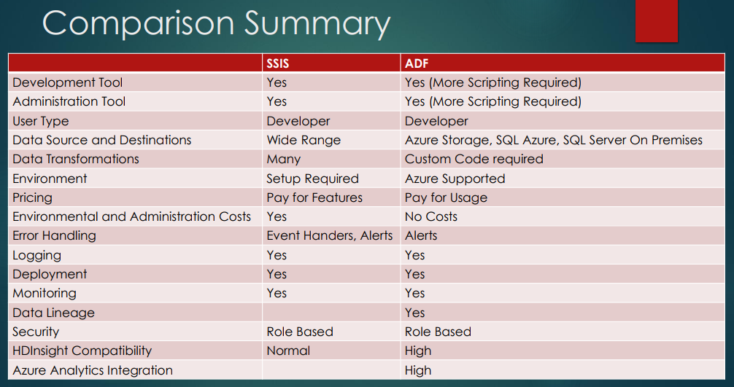

Slide 28
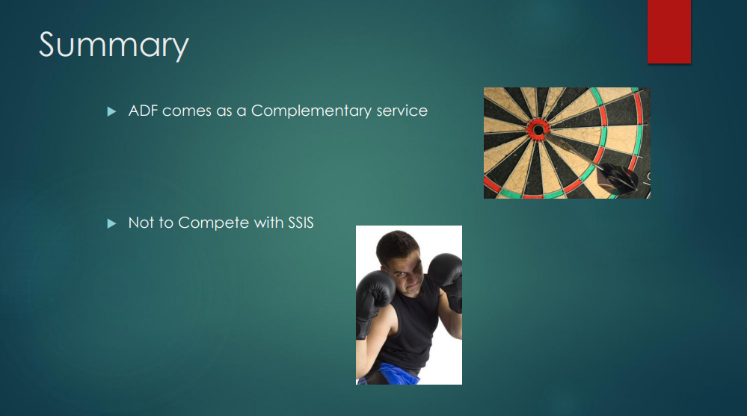

Slide 29
Concepts
Data Source
Dataset
Pipeline
is a grouping of logically related activities. It is used to group activities into a unit that performs a task
Concepts
Activities define the actions to perform on your data. Each activity takes zero or more datasets as inputs and produces one or more datasets as output.
Activity
Linked services
computing environment
Notes:
We have four main concepts.
First. Dataset is data source
Second. Activity. It’s actions to perform on your data
Third. Pipeline. It’s a grouping of logically related activities
And finally. Linked services are computing environment or external resource. For example It’ s Hive, Machine Learning, stored procedure
Let’s look at these concepts in more detail

Slide 30
Expressions & Parameters
String functions – concat, substring, replace, indexof etc.
Collection functions – length, union, first, last etc.
Logic functions – equals, less than, greater than, and, or, not etc.
Conversation functions – coalesce, xpath, array, int, string, json etc.
Math functions – add, sub, div, mod, min, max etc.
Date functions – utcnow, addminutes, addhours, format etc.

Slide 31
System variables
Pipeline scope
Trigger scope
Variable Name
@pipeline().DataFactory
@pipeline().Pipeline
@pipeline().RunId
@pipeline().TriggerType
@pipeline().TriggerId
@pipeline().TriggerName
@pipeline().TriggerTime
Variable Name
trigger().scheduledTime
trigger().startTime

Slide 32
Trigger

Slide 33
Type of triggers
Manual execution
Schedule trigger: A trigger that invokes a pipeline on a wall-clock schedule.
Tumbling window trigger: A trigger that operates on a periodic interval, while also retaining state.

Slide 34
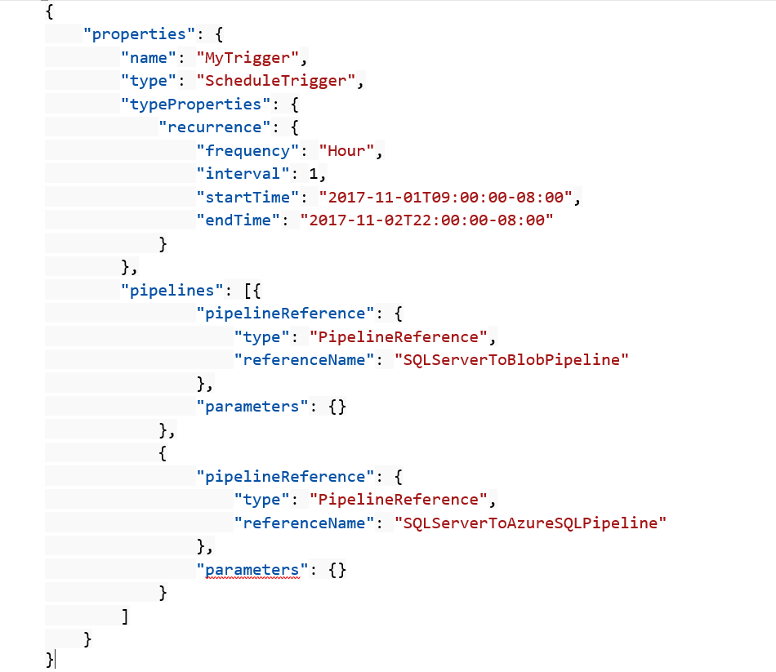
Schedule trigger
A schedule trigger runs pipelines on a wall-clock schedule. This trigger supports periodic and advanced calendar options. For example, the trigger supports intervals like "weekly" or "Monday at 5:00 PM and Thursday at 9:00 PM."

Slide 35
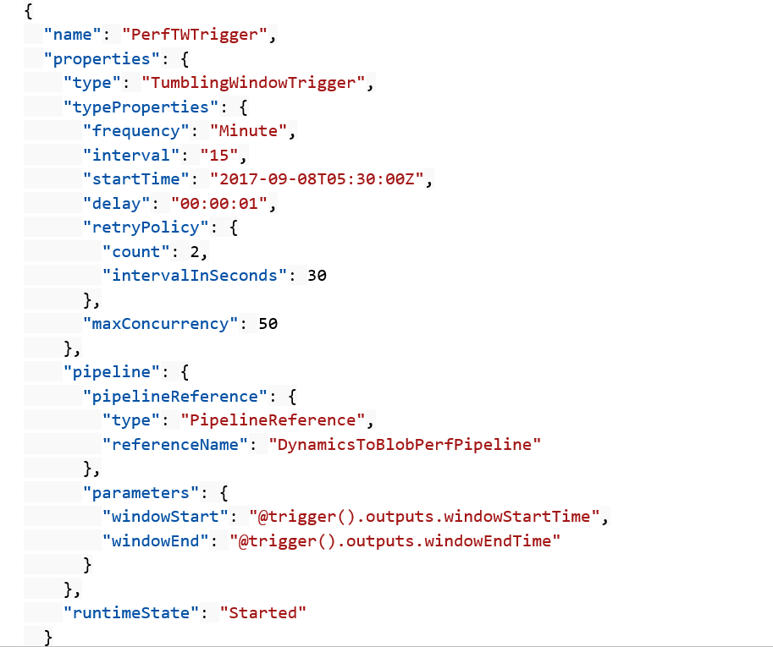
Tumbling window trigger
Tumbling window triggers are a type of trigger that fires at a periodic time interval from a specified start time, while retaining state. Tumbling windows are a series of fixed-sized, non-overlapping, and contiguous time intervals.

Slide 36
Control flow

Slide 37
Control flow
Filter activity
ForEach activity
Get metadata
Execute Pipeline
If Condition activity
Web activity
Lookup activity
Wait activity
Until activity

Slide 38
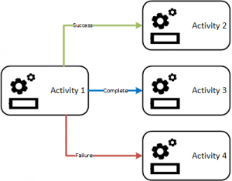
Branching
On success
On failure
On completion
On skip

Slide 39

Overview of Overall Scope of Labs
https://github.com/VectorSense/Data-Ninja-Tech-Series

Slide 40
Data Flows

Slide 52

Thank you.

